Slide 1
Unit Testing with Python
PowerPoint Presentation in Software Engineering and Testing

Slide 2
What is Test automation?
Notice that this isn’t just testing, its Automated testing.
We know the importance of testing, but just one person testing your code is inefficient, and will make errors.
So we need someone to do it for us. Consistently, and reliably every single time we need to publish software.
Automated tests exist for this reason. That is what we will be looking at in upcoming slides.

Slide 3
What is the unittest library in python?
It is a built in library in python, that provides some functions and classes so that it becomes easy to write automated tests for your code.

Slide 4
Are there other libraries?
Yes, there are many other libraries in python. Pytest is one of them. You also may wanna consider Java and C# for writing these automated tests for your code, as they also have testing frameworks written for them.
Java provides a framework called JUnit to perform the unit testing of our Java code. In the development of test-driven development, JUnit is very important. The JUnit is one of the frameworks available in the unit testing frameworks. The xUnit is the unit testing framework family, and JUnit is the part of the xUnit.
of the code. It also increases the productivity of the programmer. JUnit promotes the idea of "first testing then coding", which emphasizes setting test data for a piece of code that can be tested first and then implemented. Junit increases the stability

Slide 5
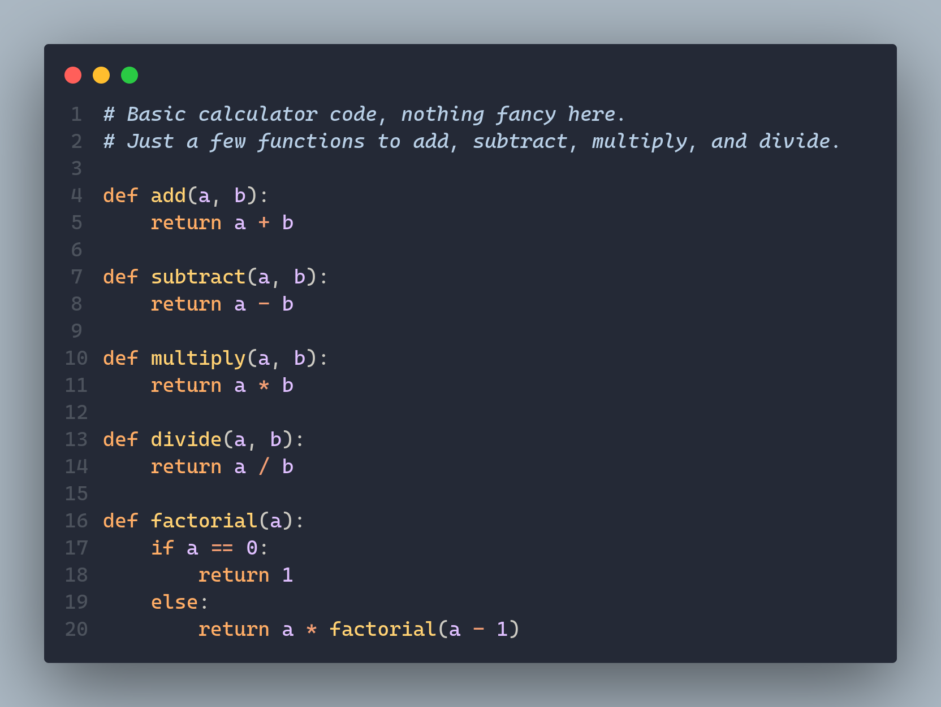
Consider this example

Slide 6
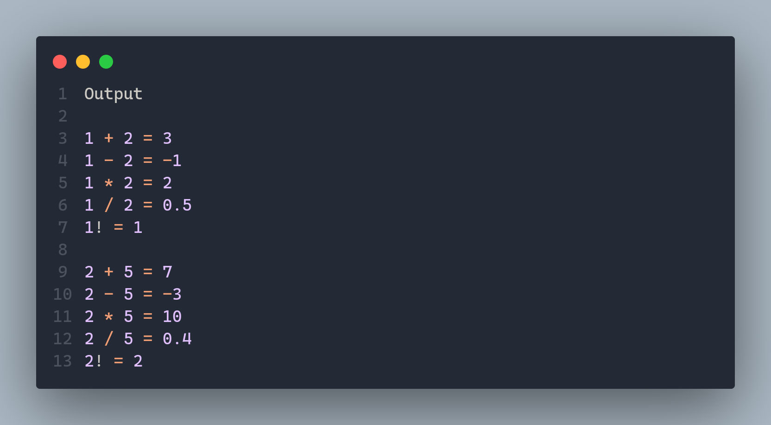
If you run that file with some example, this would be the output.

Slide 7
On the Next slide we have the testing file, this code would be saved as a separate file, that would be next to your main code. You can then import your code into your testing file, and then write as many tests as your code needs, but in a separate file to maintain some modularity in your code.

Slide 8
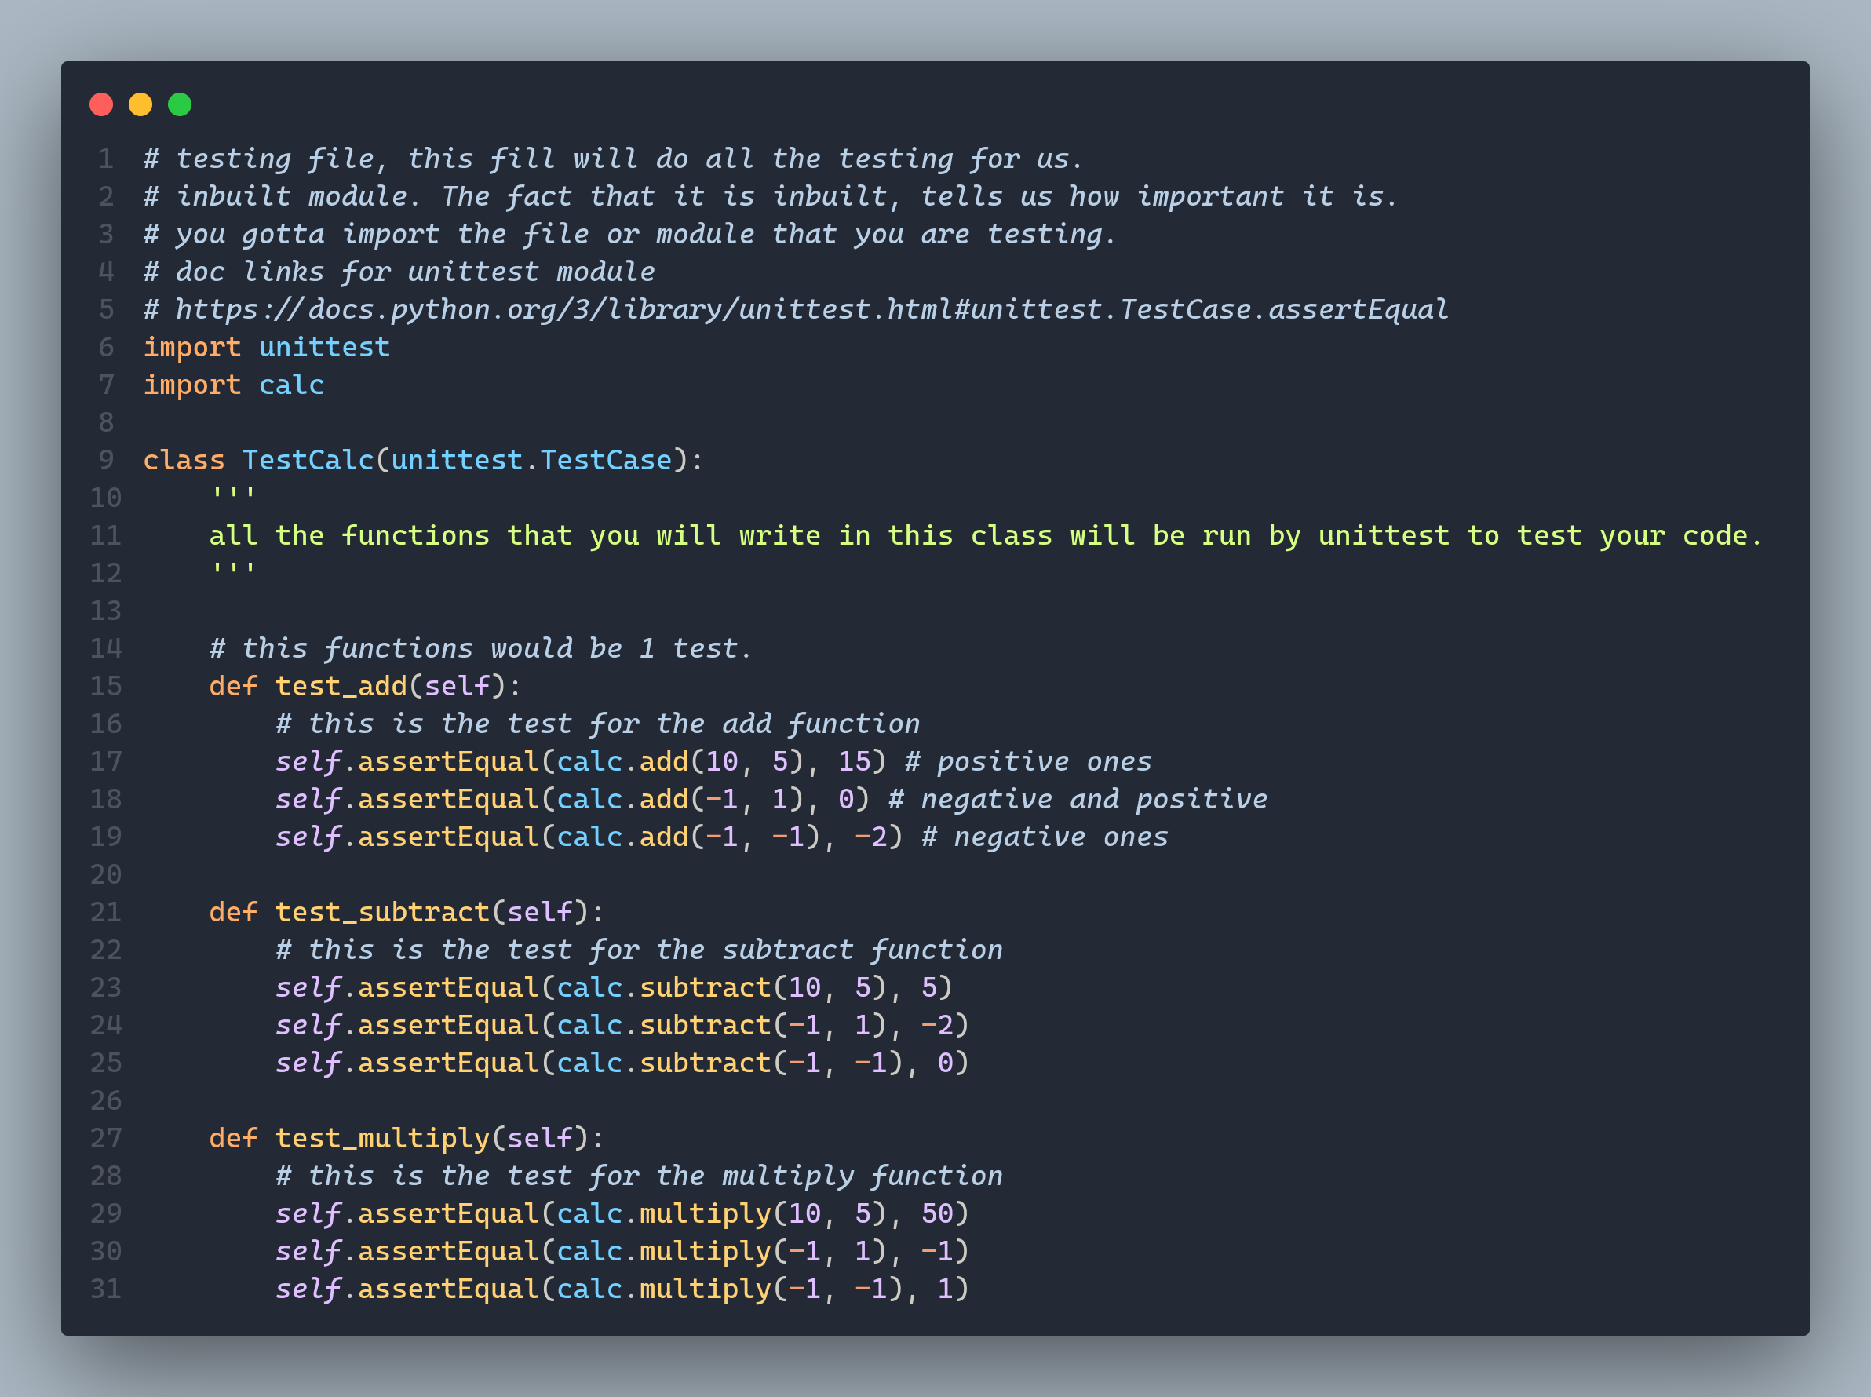

Slide 9
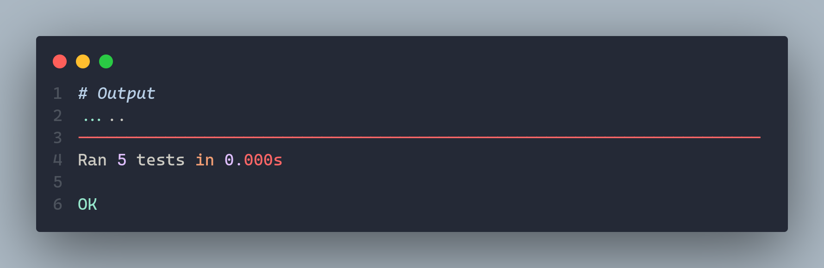
And this would be the output for the test.

Slide 10
So what is the point of all this?
Imagine a situation where you are building something like google chrome. You want it to work on all platforms, and you cant afford to mess up the code.
In such a scenario, after you write some code, you wont just publish it as the next release and prompt billions of users world wide for an update, without making sure it works, what if you made a logical error while coding?

Slide 11
To solve this universal issue in software engineering, you would naturally want to test your code, now again it is unreasonable to just run it again and again after every change you make. Which is why such libraries exist.
They offer reliability as well, if someone knows you have tested your code with unittest, or pytest, then they can trust your codebase, and you have produced ‘good’ software.

Slide 12
Will you do this as part of your job?
Most of the test creation will be done by AI in the very near future, but it will be indisputably prone to errors despite of its vast knowledge base.
There will always be a real world scenario that AI will not be able to account for, but You as the developer will have to.
For this it is essential to understand why and how EXACTLY software testing is done.

